Slide 1

Release Automation Capabilities
Enable faster time to value by e2e DevOps

Slide 2

Agenda
1
Release Automation Offerings
2
Capability Snapshot
3
Assessment Framework
4
Deployment Automation with uDeploy
5
Experience Snapshot
6
Current Engagements
7
Sample Case Study

Slide 3
TechM Release Automation Offerings
Assessment
Analyse the various Gaps in Deployment Lifecycle.
Implementation
Deployment Process model, Integration & rollout strategy.
Support
uDeploy Installation, configuration & Administration support.
Environment support, Enhancements, Troubleshooting server issues, Patch upgrade.
Prioritize the activities to be undertaken in terms of Business Benefits envisaged.
Identify integration components.
Assess Environment related factors & Cross platform dependencies and complexities.
Provide Recommendations and Roadmap.
Application components and versioning.
Environment configuration from dev/test through production.
Compliance – Audit history, Quality gates.
Environment Inventory – What is deployed where?
Training.

Slide 4













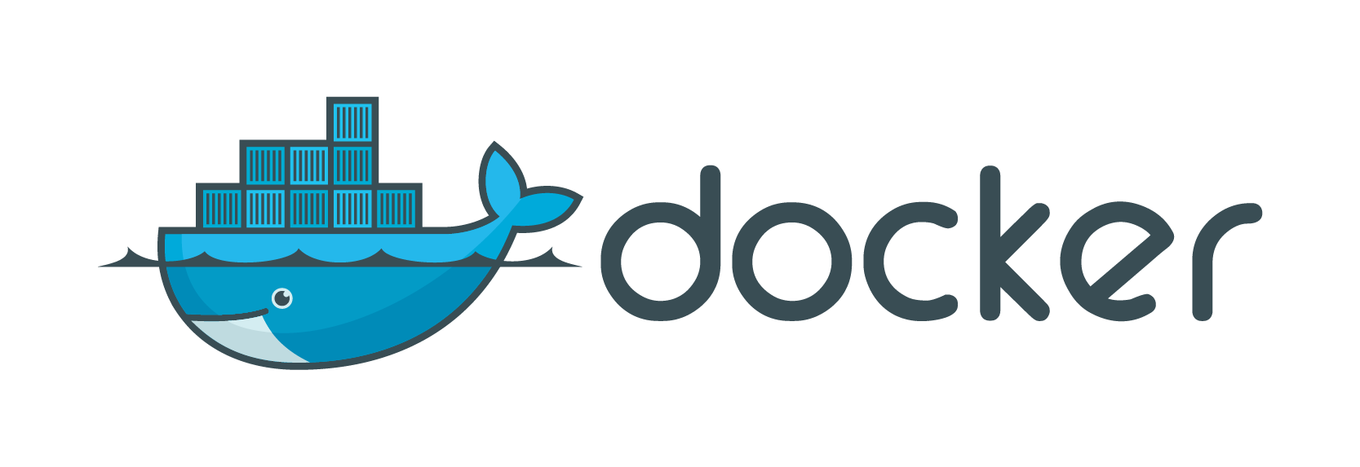









Release Automation: Capability Snapshot
People, Tools & Partnerships
100 + across projects
Area of Expertise
&
Service Offerings
Web technologies | Web services |Messaging | Open Source |Enterprise Portals |E-Commerce solutions
EAI: TIBCO, WebMethods, DataPower, BizTalk, Oracle ESB, JBoss
BSS, OSS, Enterprise Applications
Infrastructure and Application configuration
Consulting | Strategy Development and Roadmap
Product Evaluation | Architecture
Implementation | Upgrade | Migration
Managed Services | Analytics | Auditing |Testing
Proven
Experience
10
+
25
+
8
+
Engagements
Projects
Countries
Value Proposition
Business Value
Accelerate Time-to-value
Improve Application Quality
Simplify on-going maintenance
Reduce cost and time
Efficiencies
Consistent deployment across environments
Reusable components and best practices
Pre-built frameworks
Innovation & Engineering
CoE – R&D, PoC & Evaluation
ADOPT Portal (TechM IP)

Slide 5

Assessment Framework
Analysis of deployment processes
Dependencies
Application architecture and design
Dependencies
Process
Application Architecture
Assessment Framework
Analysis of underlying application infrastructure
Application Configuration
Past failures and actions taken
Deployment/Release frequency
Application Infrastructure
History

Slide 6
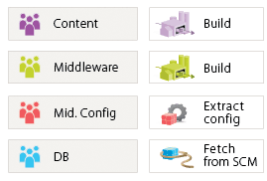

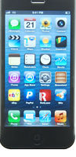
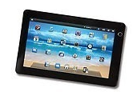
Deployment Automation with IBM uDeploy
Application Blueprint
Deployment of applications through environments
Rapidly deliver environments for testing (incl. crowd sourcing)
Easily roll back applications due to errors or changes
Fully integrated with existing investments (Tivoli, Cloud, Microsoft, Commerce, Portal)
Compliance: audit trails and security
Versioned Artifacts
Artifacts
Artifacts
Artifacts
Deploy or
Rollback
Deploy or
Rollback
Deploy or
Rollback
Execute Against
Execute Against
Execute Against
Support for dozens of technologies and heterogeneous environments
Source Control: RTC, SVN, Git, AccuRev, ClearCase,
App servers: WAS, WebLogic, JBoss, IIS, Tomcat…
Databases: MS SQL Server, Oracle SQL*Plus, JDBC…
Change Mgmt: RTC, ClearQuest, Jira, TFS, HPQC…
Quality Assurance: HPQC, Selenium, Sonar, Cobertura..
Build: Ant, MSBuild, Make, Maven…
Development Environment
QA Environment
Production Environment
Notes:
Mobile

Slide 7
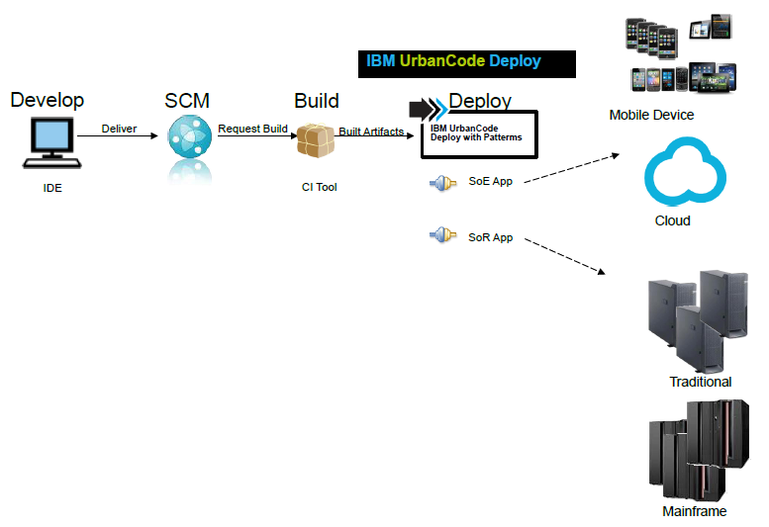
Deployment Automation: Support multiple environments
Deploy complex applications: multi-platform, multi-technology
Application in different layers develop and deploy at different velocities
Hybrid environments: Public and Private cloud, Distributed physical or virtualized servers, Mainframe, Mobile Devices, and also Smart devices
Parallel deployments can be performed on multiple servers to reduce time.
Manifest driven deployments can help achieve partial and full component deployments.
Quality Gates and Approvals Environment Quality Gates as well as Approval Processes to help you ensure that only the right stuff goes out at the right time

Slide 8
DevOps Assessment and Automation Experience Snapshot
Customer | Technology | Service | Benefits
Tier-1 Retail | Microsoft TFS, Jenkins, CA RA, CA SV | Continuous Integration Continuous Testing Continuous Deployment | Reduced downtime related to deployment by 80 to 90% Increase release volumes by 30%
Telecom Major, UK | uDeploy | Continuous Deployment | Faster release and deployment cycles Reduction of downtime related to deployment
Telecom Major, NL | uDeploy Jenkins | Continuous Integration Continuous Deployment | Faster release and deployment cycles Reduction of downtime related to deployment
Big-4 Auditing & consulting Firm | Consulting | DevOps maturity assessment | Strenghths, Weakness, Imrprovement plan Devops Implementation Plan
Retail Major - US | Jenkins uDeploy | Continuous Integration Continuous Deployment | Faster release and deployment cycles Reduction of downtime related to deployment
Global Conglomerate | AWS, Chef Jenkins | Automatic Provisioning of Environments and Deployment of Applications Runbook Automation | Improved Visibility and better utilization of resources Reduced rework and faster time to delivery
European Major Telecom | uDeploy | Continuous Deployment | Faster release and deployment cycles Reduction of downtime related to deployment
Media Major | Chef Jenkins | Infrastructure and Application Deployment Automation Continuous Monitoring | Faster release and deployment cycles Reduction in Environment Issues Proactive interventions for Environment stability
Tier-1 – Indian Telecom Player | uDeploy | Continuous Deployment | Faster release and deployment cycles Reduction of downtime related to deployment
Notes:
In response –DevOps!

Slide 9
IBM uDeploy: Current Engagements
Customer | Services | Technology Stack
Large Retail Customer - US | CI and CD Implementation | J2EE, .Net, IBM Datapower uDeploy, SVN, CVS, Jenkins, SoapUI,
Telecom Major - Europe | Deployment Automation | TIBCO, J2EE uDeploy
Large Telecom Service Provider, India | Deployment Automation | uDeploy, RTC
Large Bank, India | End-to-End | J2EE, CLM, uDeploy, RTC
Telecom Major - Europe | Environment Provisioning (cloud) | uDeploy and uDeploy Patterns, Jenkins
Telecom Major - UK | End-to-End | J2EE, CLM, uDeploy, uRelease, RTC, SVN, Rational Insight
Telecom Major – Australia | Deployment Automation | uDeploy, Siebel

Slide 10
Deployment Automation for a Telecom Australia
The mobile telecommunications company that operates the Vodafone and Crazy John's brands in Australia.
CD Implementation has just started based on UCD as the main components of the CD platform.
Broad Application and Technology Landscape
.NET and J2EE Platform
COTS Products
Siebel
Sterling eCommerce
Problem Statement
Enable Continuous Deployment for Siebel Applications.
Current way of working and issues
Mostly Manual.
Challenges
Current Manual Siebel deployment error prone.

Slide 11
Thank You
Copyright © 2016 Tech Mahindra. All rights reserved.

